Slide 1
D1: Report on good practices on DC frameworks for the health and care sector Improving digital competences of the health workforce in Spain and Estonia
June 2023
REFORM/SC2022/108 AARC - Consortium The project is financed by the European Union through the Technical Support Instrument and executed by NTT Data, in collaboration with the Directorate General for Support for Structural Reforms of the European Commission (DG REFORM)

Slide 2
Abbreviations
Acronym | Description
AD@15 | Agenda Digital de Euskadi 2015
BDRW | “Building a Digitally Ready Workforce” programme
D | Deliverable
DC | Digital Competence
DG | Directorate-General
DG REFORM | Directorate-General for Structural Reform Support
DHT | Digital Health Transformation
DSAT | NHS Digital Skills Assessment Tool
ECTS | European Credit Transfer System
EIT | European Institute of Innovation and Tech
EU | European Union
HEE | Health Education England
HIE | Electronic Health Information Exchange
HiMSS | Health Information and Management Systems Society Foundation
HWF | Healthcare Workforce
ICT | Information and Communication Technology
IS | Information Systems
IT | Information Technologies
KIC | Knowledge and Innovation Community
MD | Medical Doctor
M&E | Monitoring and Evaluation
NHS | United Kingdom National Health Service
OWG | Operational Working Group
PDP | Professional Digital Competence Profiles
PHR | Professional Human Resources
RIS | Regional Innovation Scheme
SKAD | Skills Knowledge Assessment Development Framework
TICSS | TIC Salut i Social
TRIE | Tools, Resources, Education and Information
US | United States

Slide 3
Index
1. | Introduction and objectives | 4
 | 1.1 General context | 4
 | 1.2 Objectives of Deliverable 1 | 4
2. | Methodology | 5
 | 2.1 Methodology followed | 5
 | 2.2 Structure of the thematic fiches | 6
3. | Analysis of good practices | 7
 | 3.1 Selected initiatives HITCOMP Numérique en santé Référentiel socle et transversal de compétences A Health and Care Digital Capabilities Framework COMPDIG – Salut IKANOS Psychological Practitioners Digital Competence Framework Fraunhofer Academy eitHealth Digital Health Transformation Academy | 7 8 13 15 19 24 28 34 36
4. | Conclusions | 39
5. | Bibliography | 42

Slide 4
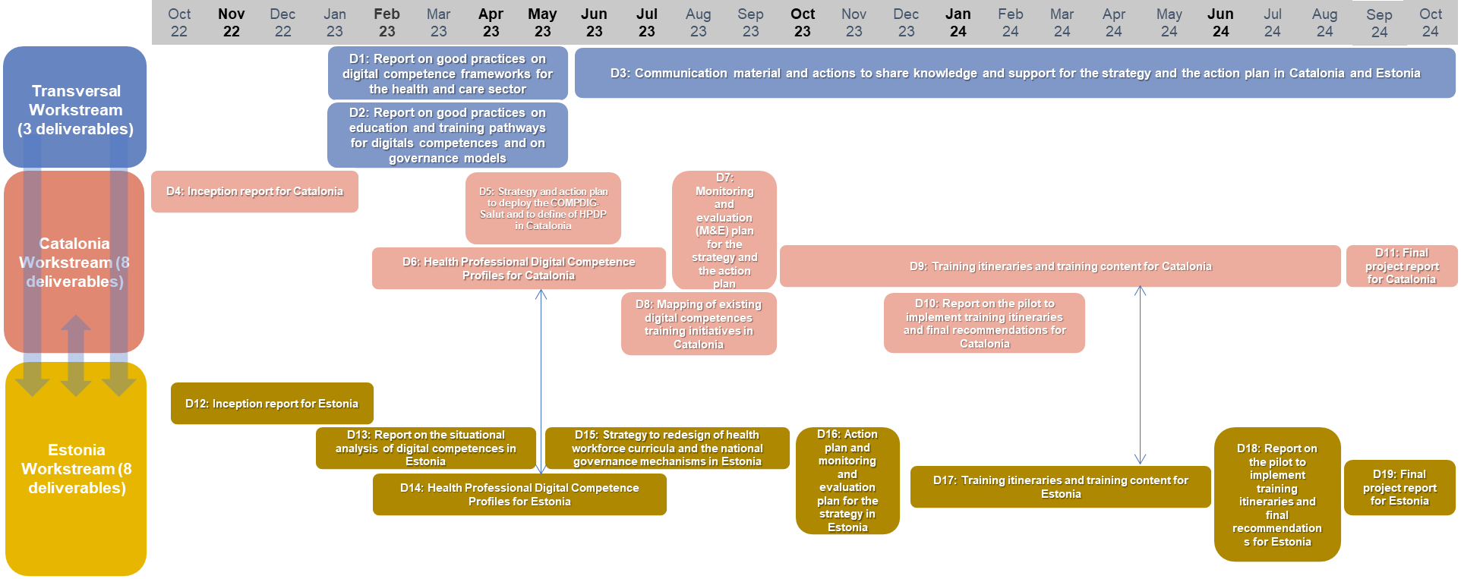
1. Introduction and objectives
1.1 General Context
This document is framed within Deliverable 1 of the project “Improving digital competences of the Health Workforce in Spain and Estonia”, financed by the European Union (EU) through the Technical Support Instrument and executed by NTT DATA, in collaboration with the Directorate General for Support for Structural Reforms of the European Commission (DG REFORM).
The main objective of the project is to improve Digital Competencies (DCs) among the Catalan and Estonian Healthcare Workforce (HWF). For the purpose of this project, digital competences are defined as the “combination of knowledge, skills and attitudes in the confident and critical use of Information Communication Technology (ICT), for work, leisure and communication”. The main outcome expected is the implementation by health authorities of a strategy to standardise, assess and improve DCs of the HWF, to bolster the access and quality of services for patients.
The project consists of 19 phases, and this document constitutes the Final Report of Deliverable 1 (D1): “Report on good practices on DC frameworks for the health and care sector”.
Figure 1: Project workstreams and activities overview
1.2 Objectives of Deliverable 1
In the context of D1, the specific objectives are the following:
To identify and analyse competence frameworks and Professional Digital Competence Profiles (PDPs) used in the health and other sectors
To collect information on the methodological approach used to define digital health profiles
Conduct a desk research about the most relevant initiatives considering the specific needs of Catalonia and Estonia
For this deliverable, this report presenting the good practices on DC frameworks constitutes the final task.
4

Slide 5
2. Methodology
2.1 Methodology followed
1
Identification of initiatives through desk research
This first phase of the deliverable involved identifying initiatives related to DC frameworks, PDPs, and their monitoring and evaluation (M&E) mechanisms through and exhaustive desk research, with the goal of later selecting up to 15 of them in a Selection workshop.
Before carrying out this desk research, an investigation protocol was agreed upon with the Operational Working Groups (OWGs), setting the guidelines to follow in this activity. In this protocol, a pre-proposal of the thematic fiche’s index was also validated.
For this initial desk research, information was gathered from databases of official sources of the health administrations and organizations that established the frameworks (primary sources) and existing publications in other databases such as Pubmed, JSTOR, or Google Scholar (secondary sources).
The previous and ongoing experience of TIC Salut I Social (TICSS) and the European Commission was also considered as a source of information.
2
Elaboration of preliminary fiches
Information gathered in the desk research on the different initiatives was organised through preliminary fiches. For each of them, basic information (year, driving institution, scope) was provided, as well as a brief description on the content of the initiative. These fiches were to be later presented in a selection workshop, in which the initiatives to further develop for the final report would be defined.
In total, a document with preliminary fiches for 27 initiatives was elaborated, including 17 DC frameworks, 9 certification processes , 4 PDPs in the health sector, 2 PDPs in non-health sectors, and 2 M&E mechanisms. Some initiatives included more than one area of focus.
This document also included a preliminary selection criteria for the initiatives, to be validated by the beneficiaries in the selection workshop.
3
Selection workshop
The 27 initiatives were presented to both OWGs in this selection workshop. Firstly, the criteria to be used to select initiatives was agreed upon. Having done this, initiatives were then presented individually, with a brief debate ensuing regarding their fit with the selection criteria. Following the debate, each beneficiary cast a telematic vote, evaluating each initiative on a scale of 1 to 5.
After all initiatives had been voted on, average scores for all of them were shown. With this information, a second debate was then carried out, with the intention of defining the initiatives that would be focused on for the final report. From it, a selection of 8 initiatives was finally agreed upon.
4
Elaboration of the final report
Having selected the 8 initiatives, further information on the context of their production, driving institution, and complimentary tools was compiled and reproduced in the resulting final report.
5

Slide 6
2. Methodology
I. General data
II. Context of the initiative & driving institution
III. Description of the DC framework/training and certification initiative
IV. Other tools of the initiative (PDPs/certifications/trainings…)
2.2 Structure of the thematic fiches
To present the information collected on the selected initiatives, a thematic fiche has been elaborated. Fiches are organised through the following index (with variations considering the content of the initiative):
In the following illustrative, the different elements and information provided in the fiches is explained:
Title of the initiative
Icons showing the areas of focus of the initiative –
Blue: considered in this initiative
Grey: not considered in this initiative
Driving institution
Year of development
Link to the source
Original scope of application
Title of the section
Content of the section
Icon meanings:
DC frameworks
PDPs
Certification initiatives
6

Slide 7
3. Analysis of good practices
3.1 Selected initiatives
The 8 initiatives chosen in the selection workshop, and further developed in this final report are the following:
Initiative
Brief description
1
EU and United States (US) collaboration to develop a framework with 1,025 competencies
HITCOMP
Numérique en santé Référentiel socle
et transversal de compétences
French initiative to include digital skills in the curriculum of health students
2
A Health and Care Digital
Capabilities Framework
DC framework developed by the NHS applicable to all HWF
3
COMPDIG - Salut
Framework developed by TICSS directed to the Catalan HWF
4
IKANOS
Overarching initiative by the Basque Government with basis on the DIGCOMP
5
Psychological Practitioners Digital
Competence Framework
DC framework developed by the NHS with special focus on psychologists
6
Fraunhofer Academy
Digital health training initiative with international scope
7
eitHealth Digital Health
Transformation Academy
European initiative to provide Digital Health Transformation training modules
8
7

Slide 8
I. General data
II. Context of the initiative & driving institution
3. Analysis of good practices
1
HITCOMP (1/5)
Driving institution:
Year:
2016
EU-US eHealth Work Project
HITCOMP Website
Scope:
EU & US
Source:
The EU-US eHealth Work Project is a European Commission-funded project under the Horizon 2020 program formed in September 2016, after a joint effort between the US and the EU (under DG Connect, specifically) back in August 2013. This workgroup was composed of the following public and private sector industry stakeholders¹:
The joint project between the US and the EU of this workgroup was divided into two phases². In Phase I (Aug 2013 to May 2015), the community identified approaches to ensure a robust supply of eHealth IT professionals and bridge the competency gap among healthcare staff for optimal use of available technology.
In Phase II (September 2016 to May 2018) the EU-US eHealth Work Project was established officially. Under the Horizon 2020 program, this workgroup had the mission of measuring, informing, educating and advancing eHealth skills, education and knowledge throughout the EU, the US and globally. It was in this phase in which a Gap Analysis was performed³, and the HITCOMP was subsequently developed, as a repository of the education, skills and DCs of all members of the HWF.
The program came to an end with the conclusion of Phase II. However, the project currently continues its dissemination and exploitation activities currently, and the HITCOMP repository is still maintained by OMS-GmbH.
Omni Micro Systems – Omni Med Solutions GmbH (OMS-GmbH): Coordinators of the project. German enterprise providing consulting services in clinical healthcare and Information Technologies (IT).
European Health Telematics Association (EHTEL): leading forum for decision makers and doers in Europe, engaged in the transformation of healthcare in Europe through eHealth.
Stiftung Fachhochschule Osnabrück (University of Applied Sciences Osnabrück): practice-oriented university considered one of the leading universities of applied sciences in Germany.
Technology University of Tampere: high-standard tech research, with close links to the needs of industry and business life.
Steinbeis 2i GmbH: worldwide acting network of research and innovation management. Partner and advisor for European innovation topics.
Health Information and Management Systems Society Foundation (HIMSS): global enterprise producing health IT thought leadership and education around the world.
8

Slide 9
III. Description of the DC framework (I)
3. Analysis of good practices
1
HITCOMP (2/5)
This DC framework contains 1,025 digital competences, sorted into 5 specific domains⁴:
Each specific domain will have a number of competences associated to it (e.g. Direct Patient Care has 317 of the 1,025 competences associated to it).
Each of these 1,025 competences are differenced by level, depending on the grade of experience and skill required to achieve them. There are 5 levels, which are color-coded in the repository for ease of understanding³:
Each individual competency is associated to a specific competency quadrant, depending on its area of focus, or general area of interaction between eHealth actors. The 6 competency quadrants are the following⁴:
Administration: health administrations, finance, law, management and revenues
Direct Patient Care: nursing, medicine, allied health, etc.
Engineering/Information Systems (IS)/Information and communication Technologies (ICT): engineering, ICT, information systems and information technology
Informatics: health informatics, clinical informatics, nursing informatics, etc.
Research/biomedicine: research, development biomedicine, etc.
1
2
3
4
5
Baseline
A foundation level upon which all other skills and competences are based
Basic
An entry-level or beginning skill or competency level. Equating to “understanding” and “knowing” according to Bloom’s Taxonomy⁵. Could potentially align with associate-level degree academic programs
Intermediate
A mid-level incumbent skill or competency level, equating to “applying” and “analysing” ⁵. Could potentially align with baccalaureate-degree level academic programs
Advanced
A high-level incumbent skill or competency level, equating to “evaluating” and “synthesizing” ⁵. Could potentially align with baccalaureate- to master-degree level academic programs
Expert
A high-level incumbent skill or competency level, equating to “evaluating” and “synthesizing” ⁵. Could potentially align with baccalaureate- to master-degree level academic programs
Administrative
Clinical
Communication
Health Data
Operational
Patient
9

Slide 10
III. Description of the DC framework (II)
3. Analysis of good practices
1
HITCOMP (3/5)
Title of the initiative:
The framework breaks down this 6 competency quadrants further, into the following 33 areas of competency. All 1,025 DCs have only one competency quadrant associated, but can have more than one area of competency assigned ⁶:
In summary, each individually coded competency is relevant for one specific domain (professional area); is assigned a level depending on the difficulty to achieve it; and is classified, first into competency quadrants, and then into areas of competency.
1
2
3
Access to Information, Protected Health Information, and Health Information Management
Administration/General Mgmt./Governance
Business Process Design/Workflows
4
5
6
Care Coordination
Clinical Decision Support and Pathways
Clinical Practice and Workflows
7
8
9
Coding and Terminologies
Collection of Data/Knowledge Mgmt. (Library)
Communication and Change Management
10
11
12
Confidentiality/Protected Health Information/Records Mgmt.
Data Compiling, Analysis, Modelling and Reporting
Documentation Process
13
14
15
Financial and Account Management
General HIT Knowledge/System Use
HIE/Interoperability/Interfaces/ Integration
16
17
18
Informatics Process
Information & Communications Technology/Information Systems/IT
Issue Management and Resolution
19
20
21
Legal
Medications and Allergies
Order Entry
22
23
24
Patient Access and Engagement/PHRs
Patient Centred Interactions/Patient Identification
Policies and Procedures
25
26
27
Population Management/Public Health
Privacy and Security
Project/Program Management
28
29
30
Quality and Safety
Research/Biomed
Risk and Compliance
31
32
33
Standards and Protocols
Systems Development and Implementation
eHealth/mHealth/Telehealth
10

Slide 11
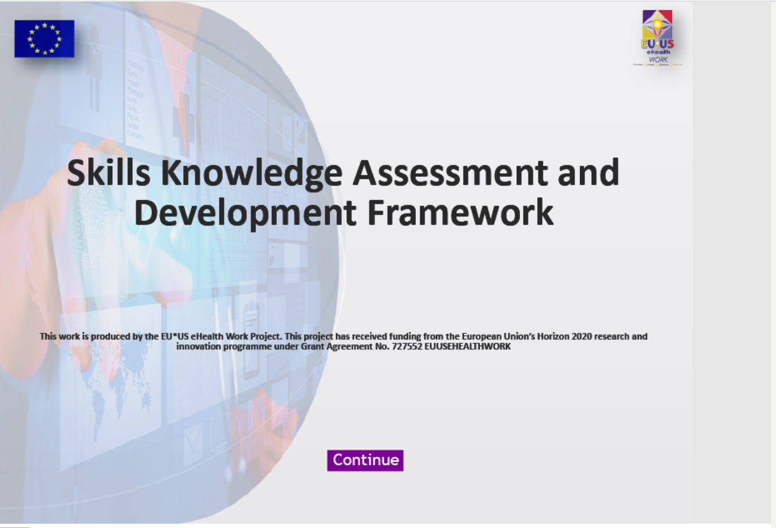
IV. DC framework database
3. Analysis of good practices
1
HITCOMP (4/5)
V. Training & Certification tools (I)
The 1,025 HITCOMP DCs have been organised into a database available for everyone. Through a set of filters, the user can produce a list of competences according to their needs, and can gather information to determine their overall digital competency level. Searches can be performed by competency or by role ⁴.
By competences: users can filter by (i) Domain; (ii) Level; (iii) Competency quadrant; and (iv) Area of competency. Once introduced, a Data Results table is produced, with a list of competences matching such characteristics.
By role: users can also obtain the set of DCs that are related to their role. To do this, they first have to determine their corresponding role, filtering by (i) Domain; (ii) Role Type and; (iii) Service Category. Once the user has determined a role that is as similar as possible to their own, users can select different competency levels (baseline, basic…etc) to produce a Professional Digital Competence Profile (PDP) with the competencies considered relevant for their role. To allow for an easier use, the database provides translations for the different roles included in several languages (including Spanish).
Illustrative
1. EU-US eHealth Work Foundational Curriculum⁷
The EU-US eHealth Foundational Curriculum is a global introductory online course in eHealth. It is tied to HITCOMP competences, providing baseline and basic eHealth skills upon completion.
The content loosely translates to the equivalent of a 60 unit/60 hour online course. It includes 10 clusters in 21 modules, broken down into 40 different areas of competences.
Competency in eHealth is considered to be achieved when all units are taken and the final examination is completed with a score of 80% or higher. This competency signification is designed to align with certification programs.
2. Skills Knowledge and Assessment Development Framework (SKAD)⁸
The SKAD is a self-assessment questionnaire that helps actors in or considering going into healthcare to better understand their digital literacy skills. It is composed of 25 questions related to technology use.
Building on the HITCOMP framework, the EU-US eHealth Work has developed several tools and resources focused on digital skills training, which are presented below.
Illustrative
Illustrative
11

Slide 12
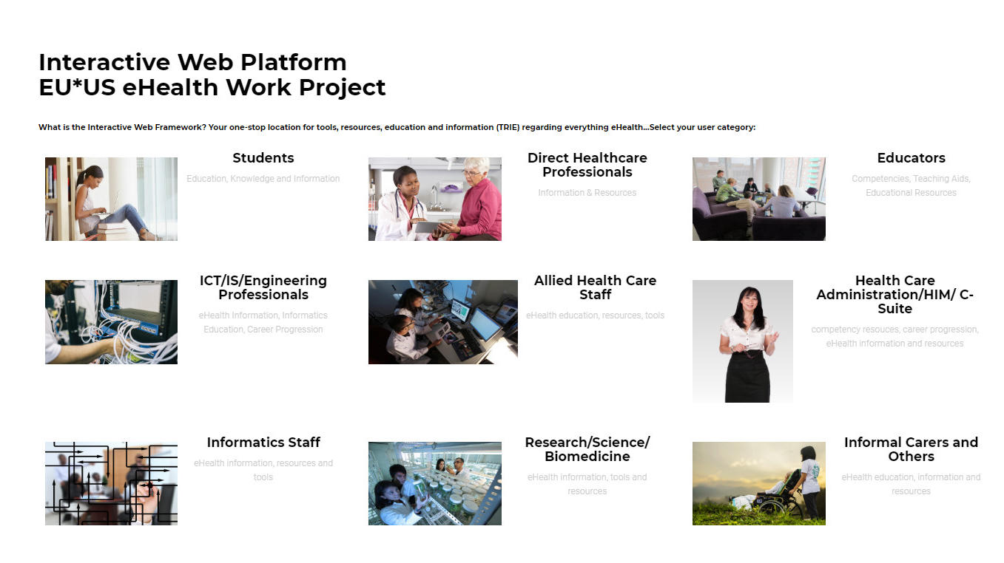
V. Training & Certification tools (II)
3. Analysis of good practices
1
HITCOMP (5/5)
3. Interactive Web Platform⁹
The Interactive Web Platform of the EU-US eHealth Work Project is the one-stop location for tools, resources, education and information (TRIE) regarding everything eHealth. It is separated by categories, including students, administration, allied healthcare staff, research, informal carers, etc.
Once the category is selected, the platform offers a set of links regarding TRIE, such as specific training platforms or links to professional associations/forums for the job category.
4. Interactive Education Demonstrator Modules¹⁰
This platform provides video instructions, presentations, information and materials related to the real-life application of education, skills and competency development related to the eHealth workforce.
It Includes video tutorials on the different tools of the website, as well as additional informative content on topics such as cybersecurity.
Illustrative
Illustrative
12

Slide 13
I. General data
II. Context of the initiative & driving institution
3. Analysis of good practices
2
Numérique en santé Référentiel socle et transversal de compétences (1/2)
Délégation Ministérielle au Numérique en Santé
Year:
2022
Driving institution:
Numerique en Santé Référentiel socle
et transversal de compétences (PDF)
Scope:
France
Source:
The development of a common framework for French health professionals is one of numerous initiatives launched as a consequence of the adoption of the “eHealth Acceleration Strategy” launched by the French Government in January 2021¹. This five-year strategy is encapsulated inside the overarching strategy to digitalise France, “France 2030”², a strategy to prepare for the future and make France a leader in eHealth, which aims to mobilise all stakeholders in the eHealth sector to create an ecosystem in which technologies are at the forefront, and health data is used in a secure and ethical manner. Other examples of initiatives arising from the “eHealth Acceleration Strategy” include the following:
The initiative of the creation of a common framework arises from the necessity to create a shared reference point that can serve as benchmark for the standardization process of training courses content, with a specific focus on students of higher education health courses. It was initiated in 2022 and has the following timeline:
The project involves the creation of this reference standard, and the publication of two decrees and a cross-functional decree that enforces the insertion of this eHealth training curricula for most health professionals. The end objective of the initiative is for the framework to be incorporated in the education of health professionals by the start of the 2023/2024 academic years.
Even though the framework considers students as their target, other training modules aimed at acting health professionals (such as the previously mentioned “eHealth training modules”) take this framework as reference when developing their content.
Assessment of skills³
eHealth training modules⁴
Users’ competences⁵
Action that aims to develop the PIX pro Santé platform for the evaluation and certification of the digital health skills of previously trained students
Action that aims to define the construction and implementation of modules to upgrade generic or specific skills to address the increased role of digital technology skills of health professionals
Action developed with the objective of allowing citizens to increase their digital health skills and be able to adequately used the technologies set up for them
Q1 2022
Q2 2022
2023/2024
Drafting of the most cross-cutting standard adapted to all health training courses
Gradual amendment of the texts governing initial training
Mandatory eHealth education in initial training for most health professionals
13

Slide 14
III. Description of the DC framework (I)
3. Analysis of good practices
2
Numérique en santé Référentiel socle et transversal de compétences (2/2)
This DC framework contains 15 competences in total, classified into 5 general domains (each with a specific allocation of teaching hours). Each competence is broken down into several capacities, which conform its specific content. The overall framework has 2 ECTS (European Credit Transfer System) and 28 total hours allocated to it. The overall outline of the framework⁶ is as follows:
These skills are expected to be developed in a practical setting, such as an internship. The framework is not meant to be static, but to be updated regularly with the arising of new technologies.
`
Health data (6 hours)
1.1. Identify a user or healthcare professional
1.2. Characterize and process personal health data by applying the regulations
1.3. Access health data while respecting professional and legal requirements
1.4. Harnessing health data for evaluation, research and innovation
Healthcare cybersecurity (5 hours)
2.1. Design and maintain a secure digital work environment
2.2. Prepare for and react to incidents
Health communication (5 hours)
3.1. Use tools to interact with users for efficient transmission of information
3.2. Interact appropriately between professionals, with the user, with carers and companions and with institutions and administration
3.3. Interact on the internet by mastering your digital identity
Digital health tools (6 hours)
4.1. Master business software and digital services
4.2. Use a connected object or a mobile application and analyse their reliability
4.3. Use the appropriate basic tools and services and identify their articulation with other shared files
4.4. Seek health evidence
Telehealth (6 hours)
5.1. Master the regulations and best practices in telehealth
5.2. Practice telehealth in conjunction with the care team and the use
14

Slide 15
I. General data
II. Context of the initiative & driving institution
3. Analysis of good practices
3
A Health and Care Digital Capabilities Framework (1/4)
Driving institution:
Year:
National Health Service (NHS) England
2017
A Health and Care Digital Capabilities Framework (PDF)
Scope:
United Kingdom
Source:
The “Health and Care Digital Capabilities framework” has its origin in the collaboration between the Building a Digital Ready Workforce (BDRW) programme (now NHS Digital Academy¹) and Health Education England (HEE)’s Technology Enhanced Learning programme². Its elaboration was one of the first steps in the development of the ongoing “Digital Readiness Education Programme^{”3}, promoted by the Department of Health in England with the vision of creating an uplift of digital skills, knowledge, understanding and awareness across the whole multi-disciplinary HWF to support new ways of working.
The NHS Digital Academy has continued developing additional initiatives related to all aspects of eHealth, using this framework as constant reference in the creation of other PDPs and profession-specific frameworks in the sector. This framework also had a key role in the development of the Topol Review in 2019⁴, a sweeping evaluation of the eHealth readiness of the NHS, carried out by Dr. Eric Topol, Notorious Medical Doctor (MD) with extended expertise in eHealth. In this review, numerous recommendations to improve the digital readiness of the healthcare sector were made, setting the basis for many of the initiatives that the NHS Digital Academy initiated ex-post. The more specific details of this strategy and related initiatives are further developed in the country analysis of the United Kingdom (Deliverable 2).
In regards to the framework in itself⁵, it is a dynamic, iterative document, that has been developed through the engagement with different stakeholders in the healthcare sector. This initiative was key not only to establish a common reference of digital skills that health professionals should be required to have, but to also identify the need of creating an easy and accessible interface in which staff can engage and self-asses their own digital literacy against the framework.
All in all, the framework identifies the different uses that it could have:
For self-assessment
To help identify learning and developmental needs
To inform personal and professional developmental plans
To guide formal, informal, directed and self-directed learning
For reflection and goal-setting
For evaluation of progress and performance
In addition, the framework is also considered referential in the development of digital literacy training initiatives, interventions and resources that can support improvement in DCs.
15

Slide 16
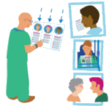
III. Description of the DC framework (I)
3. Analysis of good practices
3
A Health and Care Digital Capabilities Framework (2/4)
This DC framework is divided into 5 domains of capability, each describing specific capabilities, skills, behaviours and attitudes. There is 1 additional domain underpinning the rest (“digital identity, wellbeing, safety and security”), as the framework considers that any online activity regarding the other domains must be done within a safe and secure context.
All domains are also broken down into 4 competency levels. Each shows a set of DCs that are needed to be attained for it to be considered that the level is achieved (with Level 1 requiring the most basic competences and Level 4 the most advanced).
The domains identified in the framework, and their description are the following:
Illustrative
1. Information, Data and Content
The ability to find, manage, organise, store and share digital information, data and content.
The ability to understand and act upon appropriate guidelines, protocols, regulations and safeguards in the use of differing media, information, data and content to meet legal, ethical, cultural and security rules, requirements and expectations when working with personal, public, professional and/or confidential information, data and content.
The ability to critically analyse, evaluate and/or interpret information, data, content and their sources.
The ability to understand and adhere to digital copyright, intellectual property and privacy rules and regulations.
The ability to work with and champion the effective, secure, appropriate and innovative use of information, data and content in order to solve problems, make decisions and to achieve successful outcomes for specific goals and objectives.
2. Teaching, Learning and Self-Development
The ability to use digital technologies and tools for personal learning and professional development.
The ability to use a wide range of digital technologies and tools in teaching, coaching, mentoring others.
The ability to demonstrate and champion a positive attitude in seeking out appropriate and innovative digital technologies to enhance learning for self and others.
The ability to design digital tools/resources/activities to support the teaching and learning of self and others.
The ability to manage/monitor the learning and development of self and/or others through digital technologies and tools.
16

Slide 17
III. Description of the DC framework (II)
3. Analysis of good practices
3
A Health and Care Digital Capabilities Framework (3/4)
3. Communication, collaboration & participation
The ability to use a wide range of digital technologies to communicate with people and to understand the different nature, purpose and function of different methods of digital communication, acting accordingly and appropriately.
The ability to use digital technologies to communicate respectfully and appropriately with all people and to recognise one’s responsibility to not engage in or allow others to engage in inappropriate, irresponsible, offensive or harmful communication activities.
The ability to work collaboratively with others using digital technologies and tools to produce shared outcomes to meet shared goals.
The ability to participate actively in and across digital networks.
The ability to demonstrate and champion ethical, positive, sensitive and appropriate attitudes and behaviours in communicating, collaborating and participating with anybody and everybody.
4. Technical proficiency
The ability to use a wide range of technical devices in a personal and professional context both individually and with others
The ability to use a wide range of software and applications for personal and professional use both individually and with others
The ability to resolve technical challenges and problems both individually and with others
The ability to use technical knowledge to problem solve and achieve expected outputs
The ability to support others with resolving technical challenges and problems and/or acting on technical opportunities.
5. Creation, Innovation and Research
The ability to create new digital resources and/or curate existing ones working individually or in collaboration with others.
The ability to use devices, technologies, techniques and applications in research, quality improvement, audit and scholarly activities
The ability to use digital technologies to support or create new ideas, solutions and decisions
The ability to act as a digital champion or change agent
The ability to lead on and champion the effective, appropriate, creative and innovative use of digital technologies in research, scholarship and other activities.
17

Slide 18
III. Description of the DC framework (II)
3. Analysis of good practices
3
A Health and Care Digital Capabilities Framework (4/4)
IV. Training & Certification tools
All of these DCs are meant to serve as reference for any healthcare staff to understand their digital literacy level and set a path towards improvement. These DCs not only value technical skills, but also the attainment of a positive attitude towards technology and innovation.
`
6. Digital Identity, Wellbeing, Safety and Security
The ability to develop, promote and safeguard appropriate digital identity(-ies) that support a positive personal and organisational reputation
The ability to use digital technologies in ways that support personal wellbeing and safety and the wellbeing and safety of others
The ability to recognise and act upon digital situations and events that might compromise personal, professional or organisational security
The ability to demonstrate and champion ethical, positive, healthy and appropriate attitudes and behaviours in relation to digital identity, wellbeing and safety of self and others
The ability to understand and manage the impact of own and others’ activities on the environment
The NHS Digital Academy has not yet developed any certification tool that can allow healthcare staff to credit their digital literacy level. There is, however, a Digital Skills Assessment Tool (DSAT)⁶ that has been tested in one of the NHS’s hospitals ⁷, and is expected to rollout in early spring 2023.
The DSAT is an interactive online assessment tool that will allow healthcare staff to answer a set of questions to determine their current digital literacy levels. Once this questionnaire is completed, the user will be directed to relevant learning resources according to their specific skill needs. There are several identified benefits⁸ of the tool’s implementation such as the assurance of curated digital skills learning resources for HWF, or the provision of anonymised data for managers to understand and evaluate digital literacy skills and training needs of their staff.
In terms of training resources, the NHS Digital Academy has developed two platforms. The first one is the “Learning Hub^{”9}, a common repository in which healthcare workers can contribute and share external learning resources that could be of use for their colleagues. The second one is the “NHS Digital Academy learning programmes^{”10} which compiles the different learning offerings that the institution provides, bearing in mind competency levels and specific professions.
It should be noted that the NHS Digital Academy is an ongoing project from which many other tools are expected to be developed in the following years.
18

Slide 19
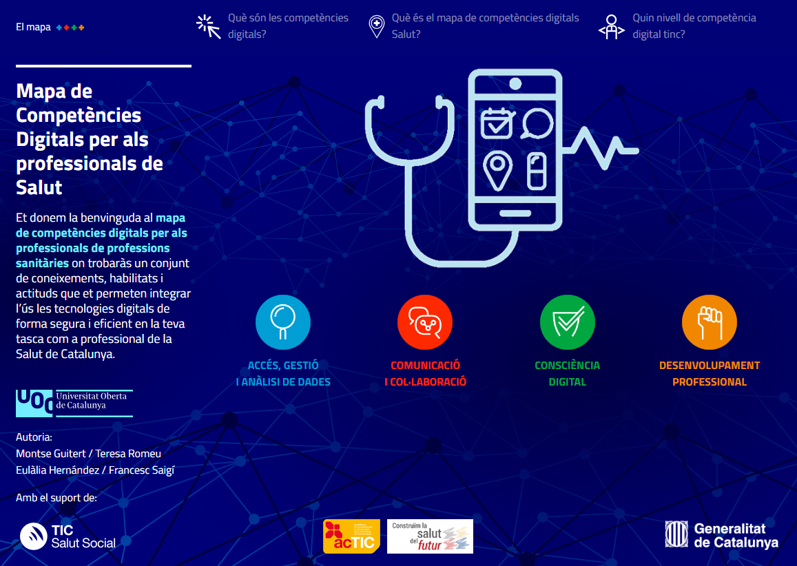
I. General data
II. Context of the initiative & driving institution
3. Analysis of good practices
4
COMPDIG – Salut (1/5)
Driving institution:
Year:
2021
Fundació TIC Salut Social,
Departament de Salut
COMPDIG – Salut (PDF)
Scope:
Catalonia (Spain)
Source:
The starting point for this initiative was the “Fòrum del Diàleg Professional” (Professional Dialogue Forum)^{1,} promoted by the Catalan Health Department with the aim of aligning planning and professional organization policies with the existing healthcare models and give response to the new health necessities of the population. One of the challenges uncovered was the “necessity to improve the digital competences of healthcare professionals” ² in the Catalan health sector.
“Digital Skills for Healthcare Professionals (COMPDIG-Salut)” project arose with the aim of meeting this challenge by addressing three objectives: (1) defining a specific digital competence framework for HPs; (2) creating a specific evaluation and accreditation model for HPs; and (3) drawing up actions to train and qualify HPs in digital competences³. With respect to objective 1, the Fundació TIC Salut Social relied on the ACTIC certificate⁴, an existing certification model of DCs for Catalan citizens, which features 3 competency levels: ACTIC Basic Level (ACTIC-1); ACTIC Medium Level (ACTIC-2); and ACTIC Advanced Level (ACTIC-3). This model is based on the European Commission’s DigComp framework and was the first certification developed in Europe for citizen’s DCs. Other relevant frameworks such as the NHS’ “A Health and Care Digital Capabilities Framework” were also taken in account. The result was the production of a DC framework for Healthcare Professionals⁵ ⁶. In this process, Fundació TIC Salut Social counted with the collaboration of sector experts, as well as the validation of the members of Challenge n.4 of the Fòrum de Diàleg Professional.
In parallel, and in order to design an evaluation, certification and training model that adequately adapted to the real situation of healthcare professionals in terms of their digital skills, Fundació TIC Salut Social also established the necessity to determine the current digital competence level of workers in the sector. To do this, a complete study that included the participation of 803 healthcare professionals was carried out, with its results determining that two thirds (66,7%) of the participating healthcare workers showed a digital competency level below ACTIC-2 (Medium Level)⁷.
Illustrative
19

Slide 20
III. Description of the DC framework (I)
3. Analysis of good practices
4
COMPDIG – Salut (2/5)
This DC framework has 4 thematic areas which are in themselves composed of 10 DCs. The 4 thematic areas are the following:
Each competence includes the key words and indicators that allow the evaluation of these DCs and serve as benchmark to determine if they are achieved at an advanced level. This framework aims to situate and orientate professionals on the digital competences to develop in the exercise of their profession in a secure, civic and critical manner in the context of digital transformation in the healthcare sector.
The competence framework⁵ is broken down as follows:
1. Access, management and Data Analysis
Access, management and Data Analysis
Communication and Collaboration
Digital Consciousness
Professional development
Competence | Indicators (Advanced Level)
1. Data Management Manages social and sanitary data and information in any of its phases (access, gathering, monitoring, saving, recovery, filtering, elimination, etc.) originating from different sources of information, and with different formats. | 1.1. Uses the most appropriate sources of health and social information depending on the objective in hand.
1.2. Characterize and process personal health data by applying the regulations | 1.2. Ensures that the information linked to health and social records reflects its suitability, quality, integrity and authenticity.
1.3. Access health data while respecting professional and legal requirements | 1.3. Applies and promotes organizational and regulatory policies and measures that ensure access, gathering, monitoring, saving, recovery, filtering and elimination of social and sanitary data with regards to its professional role.
2. Data Analysis Analyses and interprets data and data sets with the help of algorithms, artificial intelligence, Big Data and digital tools. | 2.1. Obtains data from websites, services and/or apps and treats them to facilitate the taking of decisions in the healthcare environment (command frames, business intelligence tools, web analytics, etc.).
 | 2.2. Organizes and synthetizes data to create, execute and analyse reports with regards to its professional role.
 | 2.3. Selects and designs optimal indicators to measure, compare, group and relate data depending on its purpose.
20

Slide 21
III. Description of the DC framework (II)
3. Analysis of good practices
4
COMPDIG – Salut (3/5)
2. Communication and Collaboration
Competence | Indicators (Advanced Level)
3. Communication Encourages the communication, interaction and information and social and sanitary data exchange through digital tools (synchronous/asynchronous) and adapted to the different implicated actors. | 3.1. Promotes the use of digital health communication tools to facilitate the assistance, which can be online.
1.2. Characterize and process personal health data by applying the regulations | 3.2. Chooses and uses the communication digital tool that is more adequate depending on the context and the actors implicated in the different available services.
1.3. Access health data while respecting professional and legal requirements | 3.3. Gives support to the different actors in the utilization of tools to exchange sanitary and social data.
4. Collaboration Empowers and promotes the networking collaboration between different actors with shared objectives and purposes. | 4.1. Promotes the incorporation of digital tools to innovate or improve the collaboration and group work methodologies in the sanitary environment.
 | 4.2. Detects and actively participates in the different networks linked to the sanitary and social ambit, at a national and international scale.
 | 4.3. Promotes the connection between different people and organizations in networks inked to the sanitary and social ambit, with the purpose of exchanging learning, knowledge, resources and best practices.
5. Digital Content Creates, publishes and shares health-related digital content, evaluating the context and the most appropriate channel with regards to the objective and the recipients (citizens, healthcare service users, healthcare professionals or externals). | 5.1. Uses design and editing tools to produce scientific-sanitary content adapted to recipients and the communication channel in question.
 | 5.2. Defines a strategy of publication and digital diffusion to accomplish objectives defined depending on its professional role.
21

Slide 22
III. Description of the DC framework (I)
3. Analysis of good practices
4
COMPDIG – Salut (4/5)
3. Digital Consciousness
4. Professional development
Competence | Indicators (Advanced Level)
6. Data Protection Ensure the accomplishment of protocols, and regulatory frameworks on privacy, confidentiality and protection of information and sanitary and social data. | 6.1. Applies the current requirements on privacy, confidentiality and protection of the sanitary and social data.
1.2. Characterize and process personal health data by applying the regulations | 6.2. Evaluates in a critical manner the requirements of privacy and security related with the registries and divulgation of protected sanitary and social information, according to the professional role.
1.3. Access health data while respecting professional and legal requirements | 6.3. Informs and denounces any improper breach, retainment or destruction of sanitary and social information, and ensures that the optimal corrective measures are taken when the privacy or security of any confidential information has been compromised.
7. Ethics and civility Applies the ethical principles, security and civility criteria ain the responsible use of digital technologies – channels, tools and languages – in health. | 7.1. Uses mechanisms to maintain the security of systems and devices in the exchange of sanitary and social information.
 | 7.2. Respects author’s rights and uses licenses of intellectual property when it designs, implements, investigates and/or spreads sanitary or social content.
 | 7.3. Promotes and guarantees good practices of respect, coexistence, and ethics in the digital and sanitary environment.
Competence | Indicators (Advanced Level)
8. Digital Capacitation Trains and updates itself in digital health constantly. | 8.1. Shows a critic and proactive attitude for the learning in digital competences throughout its professional life.
1.2. Characterize and process personal health data by applying the regulations | 8.2. Identifies more advanced technologies and evaluates the possibilities that they have in the health ambit.
9. Digital Identity Manages its professional digital identity and ensures an optimal digital reputation. | 9.1. Protects its professional digital identity and is able to difference it from its personal digital identity.
 | 9.2. Monitors and applies strategies to optimize its professional digital reputation.
10. Digital Transformation Participates and promotes digital transformation in the health ambit. | 10.1. Participates in the (re)definition of digital transformation processes depending on its role in the institution.
 | 10.2. Searches and prioritizes the creation of solutions and/or digital products in the sanitary ambit, with regards to its professional role.
 | 10.3. Actively and constructively participates in the debate on digital transformation in the social and sanitary ambit.
22

Slide 23
IV. Description of the Professional Digital Profiles
3. Analysis of good practices
4
COMPDIG – Salut (5/5)
In the process of developing an evaluation and accreditation model for the previously stated competencies, it was felt that, given the heterogeneity of roles and tasks in the health sector, it would not be possible to properly evaluate all healthcare workers with one common test. Taking this into account, four professional profiles were defined:
A common evaluation model was designed but contextualized in the defined profiles. It was piloted in an assimilable environment in the telematic test of ACTIC, with the objective of identifying improvements from the point of view of the professional training model (time, number and type of questions, professional profiles, etc…). 122 professionals participated in the study⁸. The conclusions of this study determined that It is necessary to review the evaluation and accreditation strategy of the project.
Currently, a review of the framework is being carried out to make the necessary adjustments from the results obtained in the different studies carried out.
Profile
Description
Role examples
Professionals who spend more than 70% of their workday giving assistance or service to patients directly
Doctors
Nurses
Occupational therapists
Logopaedist
Optometrists
Dental hygienist
Assistance with direct patient contact
Assistance without direct patient contact
Professionals who spend more than 70% of their workday giving support to assistance services
Biology/physics/chemistry specialist
Pharmaceutical
Dental prosthetic
Professionals who spend more than 70% of their workday offering services in the ambits of innovation, research or teaching
Innovation, research and teaching
Investigators
Innovation technicians
Professionals who spend more than 70% of their workday managing centres, entities, departments, services or work teams
Management
Directors
Middle managers
23

Slide 24
I. General data
II. Context of the initiative & driving institution
3. Analysis of good practices
5
IKANOS (1/4)
Driving institution:
Year:
2012
Basque Country Government
IKANOS Website
Scope:
Basque Country (Spain)
Source:
The IKANOS project¹ was launched by the Basque Country Government in 2012 as a part of its overarching strategy “Agenda Digital de Euskadi 2015 (AD@15)”² to create a learning support infrastructure for the digital competence needs of citizens, enterprises, civil servants, and others. The DigComp framework, developed by the European Commission, was taken as a reference framework in the development of all its initiatives and profession–specific frameworks.
From the beginning, the AD@15 strategy held the objective of incorporating and further developing the many ICT training initiatives that were already underway at the time into a comprehensive and clear system. To ensure this, IKANOS established a user pathway that was easy to follow, which it birthed as the IKANOS model, and serves as a great reference of the process to follow in similar digitalization strategies.
IKANOS Model:³
The IKANOS model shows the course of action that a citizen must follow in the process of improving its digital skills. Even if not specifically developed for them, this model can also be applied for healthcare workers. The model separates activities in two categories: Strategy (defining the skills needed to be improved); and Action (improving these identified skills).
Overall, it is a 6-step process, where tools have been developed by IKANOS for each phase:
The overall objective of IKANOS is to clearly provide a complete process of learning and enhancement of digital skills. Given the many tools developed, any citizen can follow an all-encompassing learning route by making use exclusively of the platform’s tools. In addition, the design it follows makes it easily replicable for different professional categories.
Discover: IKANOS Site
Audit: Self-assessment Test & Personal Digital Profile
Analyse: Professional Digital Profile
Guide: Orientation Guide & Resource Cataloguing
Learn: PLE e-portfolio
Evidence: BAIT Digital Skills Certification
Illustrative
STRATEGY
ACTION
24

Slide 25
III. Description of the DC framework (I)⁴
3. Analysis of good practices
5
IKANOS (2/4)
The development of each profession-specific profile elaborated by IKANOS (including the one for primary care health professionals) is done by adapting the DigComp framework. The original 5 areas and 21 competences of DigComp are maintained, and additional sub-competences are developed for each specific profession which is being profiled, depending on the specific digital needs that the occupation requires.
From this starting point, for each specific profession, these DigComp competences and its sub-competences are classified in terms of relevance as:
Core: DCs that are mandatory for the activities associated with the given job.
Transversal: DCs which are common to all ICT-based work in the sector.
Complementary: DCs that are helpful and enhance work performance but are not strictly necessary to carry out the job in question .
DigComp competences may not be included if they have no relevance in the profession’s activity.
Each competence and sub-competence in a PDP has a level of expertise that is expected to be achieved. There are 4 possible levels:
Basic: A1, A2
Intermediate: B1, B2
Advanced: C1, C2
Expert: D1, D2
The development of these PDPs involves a two step-process. First, the main activities performed in the profession in question are described, reflecting the different levels of experience and proficiency required for the different tasks identified. Secondly, tasks which can be performed using digital tools are identified, and these tasks are then associated with the different DigComp competences and proficiency levels.
Interviews with experts in the field are carried out throughout this process to identify further details in the aspects of these job tasks, and to specify the description of the different competences.
Once the specific framework is designed, users can then evaluate their proficiency in each competency and observe their current gap against the expected level for their profession, through the IKANOS self-assessment test. By this way, users can get a very clear idea of the competences they have to put more focus on (those in which their level is far from the expected level) and can thus tailor their learning needs. This system can aid not only users themselves, but also employers, who can get a clear idea of what level of digital skills they should be aiming to obtain from their candidates.
In e-Health, 3 PDPs have been elaborated thus far:
Primary Care Doctor
Primary Care Leader
Health Centre Administrative
`
25

Slide 26
III. Description of the DC framework (I)
3. Analysis of good practices
5
IKANOS (3/4)
The following table shows the DC framework elaborated for primary health professionals. As explained previously, the framework starts with DigComp’s 5 areas and 21 competences. Some competences have profession-specific sub-competences (e.g. 1.1.1. “Use of internal clinical information services”) arising from it. There is an expected level for all competences and sub-competences.
Competences are color-coded, depending on whether they are core, transversal or complementary. Competences in grey are those included in DigComp, but considered not relevant for the profession analysed.
`
Area | Competence | Expected level
Information | 1.1. Browsing, searching and filtering data, information and digital content | C1
 | 1.1.1. Use internal clinical information services | C1
 | 1.1.2. Use external clinical information services | C1
 | 1.2. Evaluating data, information and digital content | C1
 | 1.2.1. Value the quality of clinical information (PILAR) | C1
 | 1.2.2. Value patient apps | B2
 | 1.3. Managing data, information and digital content | C1
 | 1.3.1. Know and maintain an Integrated Management system | C1
 | 1.3.2. Order and delete versions of documents | B1
 | 1.3.3. Content adaptation | B2
Communication | 2.1. Interacting through digital technologies | B2
 | 2.1.1. Make videocalls with Lync | B2
 | 2.2. Sharing through digital technologies | B2
 | 2.2.1. Share documents through Osabox | C1
 | 2.2.2. Use Osabegi to share information | B1
 | 2.3. Engaging in citizenship through digital technologies | -
 | 2.4 Collaborating through digital technologies | B2
 | 2.4.1. Manage knowledge through Jakinsarea | B1
 | 2.4.2 Collaborate in projects through Osagune | B2
 | 2.4.3. Increase online relation with clients | B1
 | 2.5 Netiquette | B1
 | 2.6 Managing digital identity | A1
26

Slide 27
III. Description of the DC framework (III)
3. Analysis of good practices
5
IKANOS (4/4)
`
Area | Competence | Expected level
Digital Content Creation | 3.1. Developing digital content | C1
 | 3.2. Integrating and re-elaborating digital content | C1
 | 3.3. Copyright and licences | A2
 | 3.4. Programming | A2
Safety | 4.1. Protecting devices | A2
 | 4.2. Protecting personal data and privacy | A2
 | 4.3. Protecting health and well-being | A2
 | 4.4. Protecting the environment | A2
Problem Solving | 5.1. Solving technical problems | A2
 | 5.2. Identifying needs and technological responses | A2
 | 5.3. Creatively using digital technologies | -
 | 5.4. Identifying digital competence gaps | A2
IV. Training & Certification tools
Table X. Required competences and expected levels for primary health professionals
Amongst the most relevant IKANOS tools, we highlight the following:
1. Self-assessment tool⁵:
Evaluation test where citizens and professionals can test their digital skills and observe what areas they should focus on. There is a general test that is applicable to the whole population and others which are specific for certain professions (with reference to the respective PDP).
2. Guide for professional digital profiling⁶:
Aid for the conduction of the interview with experts for a specific occupation. Includes descriptors of DigComp framework, so that the interviewer can ask whether the examples mentioned apply to each profession.
3. BAIT Digital Skills Certification⁷:
External DC certification system developed by the Basque Government to evaluate and certify user’s digital skills. The platform provides several tasks, where the user has to complete using different DigComp competences. If the user is successful, he/she can receive a certification crediting his/her skills. This certification system is equivalent to TIC’s ACTIC.
Illustrative
Illustrative
Illustrative
27

Slide 28
I. General data
II. Context of the initiative & driving institution
3. Analysis of good practices
6
Psychological Practitioners Digital Competence Framework (1/6)
Driving institution:
Year:
2019
National Health Service (NHS)
III. Description of the DC framework (I) ⁴
Psychological Practitioners Digital
Competence Framework Website
Scope:
United Kingdom
Source:
The “Psychological Practitioners Digital Competence Framework” is one of four profession-specific frameworks¹ developed by the NHS Digital Academy in the context of the “Digital Readiness Education Programme”² promoted by United Kingdom’s Department of Health (see fiche on “A Health and Care Digital Capabilities Framework”).
In the context of this strategy, the NHS Digital Academy considered that psychologists required a tailored framework that supported the development of DCs for all professionals in the sector. The framework obtained can be used by practitioners and trainers as a reference to monitor DCs, design curriculums and define the learning outcomes that digital practice should have. It is considered to have a broad application, so it’s expected for each clinical institution to adapt it to their particular setting ³.
The framework was prepared by an expert reference group of the British Psychological Society drawing together academics, professionals and practitioners with experience in digital mental health. It is a framework that has been validated with psychological practitioners and trainers in two consultations in 2019 and 2020.
The framework is structured into 8 domains, with the first (“meta-competences”) including overarching factors that inform and overlap with the other seven. Each domain is then described with “Knowledge” and “Abilities” that psychological practitioners would be expected to achieve.
For some competences, further detail about the specific knowledge and skills is given. In their description, these are differentiated in terms of “Core”: expected to be achieved by all practitioners; and “Advanced”: might only be achieved by psychologists with further experience in digital mental health.
The 8 domains are the following:
Meta – Competencies
Clinical Information Governance
Assessment & Formulation
Evaluation and Research
Psychological Intervention
Communication and Teaching
Leadership, Supervision and Consultation
Personal & Professional Skills and Values
28

Slide 29
III. Description of the DC framework (II)
3. Analysis of good practices
6
Psychological Practitioners Digital Competence Framework (2/6)
Meta – Competencies
Clinical Information Governance
Knowledge | Ability
Knowledge of ethical practice, opportunities and limitations of digital practice related to access and efficacy | Ability to practice digitally, including establishing and maintaining a positive therapeutic alliance in online work
Knowledge of the legal and security requirements for conducting digital psychological assessments, interventions and supervision | Ability to appraise the advantages and drawbacks of digital tools with reference to the evidence base and recommend these to clients and services in line with one’s clinical judgement
Knowledge of professional and clinical boundary issues specific to online practice | Ability to reflect on one’s own digital psychological practice
Knowledge of psychological frameworks specific to the online therapeutic relationship such as the online disinhibition effect and screen presence | An ability to recognise one’s own competences, training and supervision needs in relation to the particular context of digital practice
Knowledge of the evidence base for digital practice (process and outcome) and how these compare to in-person approaches | Ability to recognise culture-specific requirements of clients and provide culturally appropriate psychological materials and interventions
Knowledge of profession specific guidance regarding digital practice from one’s professional/accrediting body and how these interface with broader clinical competences | Ability to work ethically, safely and effectively – attending to professional and clinical boundary issues specific to online practice
Knowledge of how diversity and cultural differences may interact with the online environment
Knowledge | Ability
Knowledge of clinical governance and professional context in relation to digital practice, including the legal frameworks for practice, clinical risk management and clinical safety online | Ability to obtain the client’s informed consent to digital work throughout the course of their contact
Knowledge of information governance and legal context of information storage and sharing -including the Data Protection Act | Ability to follow organisational policies and procedures regarding information governance, including mandatory digital training (as required by NHS or other organisational/professional body)
Knowledge of specific patient information and digital record systems used within one’s organisation and professional guidance regarding this
29

Slide 30
III. Description of the DC framework (III)
3. Analysis of good practices
6
Psychological Practitioners Digital Competence Framework (3/6)
Assessment & Formulation
Evaluation and Research
Knowledge | Ability
Knowledge of clinical safety issues (risk) associated with digital/remote therapeutic work | Ability to select online psychological assessments that are suitable for remote administration
Knowledge of opportunities and limitations of these technologies related to client factors | Ability to administer online psychological assessment tools via remote means
Knowledge of opportunities and limitations of these technologies related to clinical engagement/ therapeutic relationship | Ability to conduct accurate risk and clinical safety assessments given limitations of digital technologies
Knowledge of clinical engagement issues when conducting online screening and psychological testing | Ability to assess and match client needs/interests/abilities to suitable digital modalities
Knowledge of psychological assessment tools available for online administration in one’s own scope of practice | Ability to assess a client’s suitability for online interventions, revising this as necessary on an ongoing basis
Knowledge of inclusion and exclusion criteria for online psychological assessment and outcome monitoring | Ability to create and share a collaborative formulation with a client remotely e.g. using screen sharing of documents or white board function to draw out a formulation
Knowledge of the factors involved in choosing online platforms, ensuring their clinical safety
Knowledge | Ability
Knowledge of the evidence base for digital practice (process and outcome) and how these compare to in-person approaches | Ability to critically appraise digital tools and interventions and use the evidence base to inform selection of these for clinical and research purposes
Knowledge of digital tools for recording therapy process, evaluating client experiences and client outcomes (e.g. COREnet, etc.) | Ability to monitor patient experience and patient-reported outcomes using digital methods
 | Ability to manage outcome data collected digitally and integrate this into treatment planning
30

Slide 31
III. Description of the DC framework (IV)
3. Analysis of good practices
6
Psychological Practitioners Digital Competence Framework (4/6)
Psychological Intervention
Ability to introduce and support the use of self-help and/or blended complementary online materials to clients
Knowledge | Ability
Knowledge of contemporary digital technologies used in the direct and indirect delivery of psychological interventions | Ability to conduct therapy in individual and group format using digital technologies
Knowledge of levels of intervention and how digital technologies may be integrated at different points in a stepped care model | Ability to adapt digitally informed interventions to the needs of clients from a range of ages and abilities
Knowledge of group versus individual interventions delivered via digital technologies | Ability to recognise how employing digital technologies may influence how agreements are made with clients and/or supervisees about confidentiality and its limits e.g. safe recording and transfer of client sessions using secure cloud technology
Knowledge of the role of apps in psychological assessments and interventions and awareness of app quality assessment processes | Ability to manage outcome data collected digitally and integrate this into treatment planning
Knowledge of electronic self-help materials and platforms available to support the delivery of psychological interventions | Ability to evaluate the effectiveness and security of an app
Knowledge of different digital tools for managing between-session therapeutic contact e.g. communicating via an online psychoeducational platform or by email about home-based tasks | Ability to reflect in supervision on the client’s response to different digital modalities and the impact on the therapeutic relationship
 | Ability to introduce and support the use of self-help and/or blended complementary online materials to clients
 | Ability to integrate and use creative non-verbal visual digital tools to complement online psychological interventions e.g. using drawings with the whiteboard, shared written documents, assisting the client to select images from the internet to illustrate their feelings
 | Ability to adapt evidence-based protocols to online delivery e.g. assisting memory processing work in PTSD by facilitating a remote site visit using Google Street View
31

Slide 32
III. Description of the DC framework (V)
3. Analysis of good practices
6
Psychological Practitioners Digital Competence Framework (5/6)
Communication and Teaching
Ability to introduce and support the use of self-help and/or blended complementary online materials to clients
Knowledge | Ability
Knowledge of the pros and cons of online teaching methods and awareness of online teaching programmes | Ability to discuss the pros and cons of the digital modality with the client
Knowledge of communication processes which may affect digital practice across individual, system and group work (e.g. turn taking and use of non-verbal information) | Ability to adapt communication style and employ different functionalities of the technology concerned to promote the formation of a therapeutic relationship (e.g. adapting communication style for older people or those with learning difficulties)
Knowledge of professional and communication factors which require consideration when working with interpreters remotely | Ability to work with interpreters remotely e.g. on a video call having a British Sign Language signer or foreign language interpreter joining a call to translate for a client
 | Ability to manage boundaries if working remotely e.g. conducting a therapy session via video chat from home
 | Ability to deliver e-learning related to clinical practice and psycho-education through synchronous and asynchronous methods (e.g. eBooks, vlogs, live webinars) to clients and professionals
32

Slide 33
III. Description of the DC framework (VI)
3. Analysis of good practices
6
Psychological Practitioners Digital Competence Framework (6/6)
Leadership, Supervision and Consultation
Personal & Professional Skills and Values
to clients
Knowledge | Ability
Knowledge of digital supervision models and ways to adapt in-person supervision to online delivery | Ability to engage in remote supervision
Knowledge of leadership and consultation as it relates to digital interventions | Ability to integrate digital communications into supervision discussions (e.g. text/chat bot information, video or skype chats)
 | Ability to follow organisational policies and procedures in the making, storing and sharing of recordings of sensitive clinical material for supervision or clinical purposes
 | Ability to engage in leadership and consultation to promote an open and curious approach amongst others to digital practice
 | Ability to work in remote digital teams and participate in remote digital meetings
Knowledge | Ability
Knowledge of one’s own attitudes, skills and values regarding digital practice | An ability to reflect on one’s own attitudes, skills and values regarding digital practice
 | An ability to recognise and reflect on the limits of one’s own competence when translating original in-person professional training to online work
33

Slide 34
I. General data
II. Context of the initiative & driving institution
3. Analysis of good practices
7
Fraunhofer Academy (1/2)
Driving institutions:
Year:
2016
Fraunhofer Academy, NHS, Universitat de Barcelona, eitHealth
Fraunhofer Academy Website
Scope:
International
Source:
The Fraunhofer Academy is the Fraunhofer-Gesellschaft’s provider for continuous education. The Fraunhofer-Gesellschaft in itself is a world-leading applied research organization, founded in 1949 in German. Currently, it operates 76 institutes with 30,000 employees throughout the country, playing a major role in the innovation process of business and industry. Its has the structure of a consortium with 13 Fraunhofer Institutes (each specializing in an aera of technology) and the Fraunhofer Academy¹.
In this process of transversal digitalisation, the role of the Fraunhofer Academy is clear: to create the conditions for a new culture of innovation in companies, for an economically successful future through continuing education. It is a mission that arises from the realisation that the great investments currently being made in research could be rendered worthless if the education of professionals is not up to par with them².
Out of the different programmes that the Fraunhofer Academy currently offers, the most context-relevant one is the “Transformative Digital Skills for Healthcare”³. This online program is designed to help healthcare professionals gain digital skills and engage with new technologies to enable digital innovation improvements to be implemented in the sector. In its development, and to allow the program to gain relevance in an international context, it has relied on the following notorious international partners:
This program is aimed at all levels of healthcare professionals: clinicians, nurses, hospital management, IT; as well as other health sector stakeholders such as providers, medical device professionals or pharmaceuticals. To allow for the adaptability to all professional profiles, the program is separated in different modules, each with specific and differentiated learning objectives and content.
Fraunhofer-Gesellschaft
Brings together expertise and technologies in the fields of medicine, pharmacy and medical technology. Engagement with several institutes.
TheHill - Oxford University Hospitals, NHS Foundation
Digital innovation catalyst, bringing deep understanding of the digital challenges in the health sector. Developer of the comprehensive use cases for each module.
Universitat de Barcelona
University with well-renowned healthcare education excellence. Contributor of its large experience in Data science, Machine learning, AI and User-Interface Design.
34

Slide 35
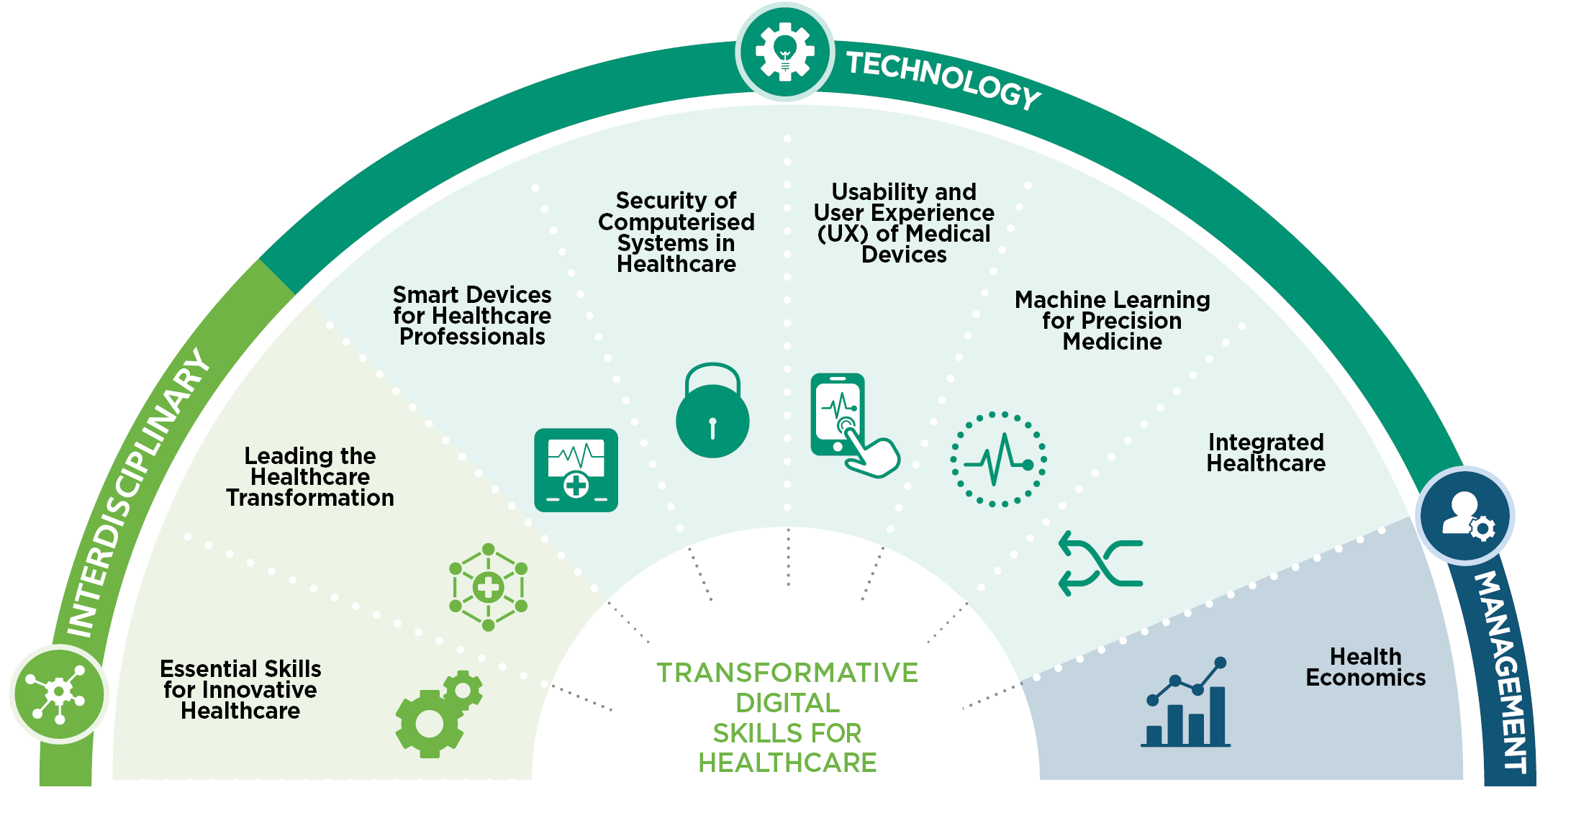
III. Description of the training and certification initiative (I)³
3. Analysis of good practices
7
Fraunhofer Academy (2/2)
The 8 possible online modules to be completed are the following:
As it can be observed, modules are separated into three categories:
Interdisciplinary: aimed at those healthcare workers that can use digital technologies as a complimentary tool to facilitate their daily tasks.
Technology: aimed at those healthcare workers in which the use of digital technologies is a key activity or is an essential tool for the carrying out of certain tasks (e.g. precision medicine).
Management: aimed at those healthcare workers that have management roles and want to enhance the use they can give to digital technologies in their tasks.
The differentiation of these categories highlights the varying level of skill that is required to complete the each of the modules included in them. This way healthcare workers can elaborate their own individual learning pathways, taking into account their existing digital skills as well as the skills that they want to accomplish.
Each module identifies specific learning objectives and outlines the content of the topics that will be covered.
All modules have the following characteristics:
Online, with self-paced learning contents, virtual live sessions and individual/peer project work
Average learning time of 15 hours, spread in a 4 to 5 week period (carried out during dates that have yet to be announced)
Certificate of completion received after the successful completion of the module
Live sessions instructed by professors and experts from the 3 partner institutions
`
Illustrative
35

Slide 36
I. General data
II. Context of the initiative & driving institution
3. Analysis of good practices
8
eitHealth Digital Health Transformation Academy (1/3)
Driving institutions:
Year:
2015
European Institute of Innovation and Technology (EIT)
eitHealth Digital Health Transformation
Academy Website
Scope:
EU
Source:
EIT Health is a “knowledge and innovation community” (KIC) established in 2015 by the European Institute of Innovation and Technology (EIT). It is one of various KICs constituted, each focusing on a different sector of innovation¹. The idea behind these KICs are to allow for a better sharing of expertise between the right people, which can permit innovation to flourish. To accomplish this optimal environment for innovation, eitHealth follows the structure of a “knowledge triangle”:
As this method requires a collaborative approach, eitHealth works with approximately 130 Health Partner organizations and thousands of start-ups and entrepreneurs². Through the creation of this ‘cluster’, numerous programs such as the Digital Health Transformation Academy are developed with the objective of finding common solutions to the most relevant challenges that the European health sector currently faces, such as the proliferation of pandemics and an aging population.
In this Digital Health Transformation Academy, the collaborating partner institutions were the following (3 of them from beneficiaries' territories):
The Digital Health Transformation Academy would fall under this scope
36

Slide 37
III. Description of the training and certification initiative³ (I)
3. Analysis of good practices
8
eitHealth Digital Health Transformation Academy (2/3)
The Digital Health Transformation Academy offers 4 courses. There is also a free, introductory, e-course in which users can learn an overview of the different aspects influencing digital transformation implementation and its relationship with innovation. The details of the 4 courses offered are the following:
To be able to enrol in any of the 4 main modules, it is required for users to have completed the introductory e-course.
All modules follow the same format, featuring a combination of online live lectures; online live workshops and self-study and assignments (the result of which allows users to obtain their certification).
The cost for the four modules previously presented varies depending on the income level of the user’s country (according to Eurostat). All modules have the same cost, except for the more advanced IDHT module, which has a higher price. The costs established are presented below:
Regional Innovation Scheme (RIS), (including Estonia and Spain countries): 200€ (IDHT – 300€)
Medium income countries: 300€ (IDHT – 450€)
High Income countries: 400€ (IDHT – 600€)
`
Digital Health Transformation in Health Institutions
Users can learn how to integrate digital transformation in healthcare and understand the different roles arising for the population of this century.
Aimed at all healthcare workers.
Technologies for Digital Healthcare Transformation
Users can get equipped with knowledge and competencies on how to engage in Digital Healthcare Transformation activities within the clinical workplace; identifying catalyst factors, barriers, challenges, and opportunities related to medical technologies.
Aimed at all healthcare workers.
Service Design for Digital Healthcare Transformation
Through this course led by TUDelft, users can get introduced to design thinking and the application it has to digital health innovation.
Aimed at healthcare workers familiar with digital health innovation.
Implementing Digital Healthcare Transformation (IDHT)
Users can acquire practical knowledge on how to deploy digital transformation. This course led by TicBiomed provides guidance, resources and cases of use to successfully transform the mindset of an organization in the support of digital technologies.
Aimed at healthcare workers in management roles.
37

Slide 38
III. Description of the training and certification initiative (III)
III. Description of the training and certification initiative (II)
3. Analysis of good practices
8
eitHealth Digital Health Transformation Academy (3/3)
Amongst the benefits of getting involved in this academy, the following are indicated:
Achieving new skills: being able to become an active transformer through on-hands learning.
Expert knowledge: benefiting from content developed by hospitals with the highest level of expertise in Europe.
Tailored content: possibility of customising the learning content and create a plan that suits your background and needs.
Networking: possibility of joining a European community of healthcare professionals and access the EIT Health Alumni Network.
All courses are open for all healthcare workers from different backgrounds. However, users should bear in mind that some courses target specific audiences, who might find the content of more interest.
Users that complete the courses can receive a European Certification by eitHealth which can credit their proficiency in the module in question.
The complete learning path followed in the use of the digital Academy is the following:
`
Intro e-course
DHT courses
Certification
Join community
Intro to challenges and opportunities of Digital Transformation in healthcare (3 hours)
Enrolment in one of four courses, focused in expertise area
(20-30 hours)
Get a European Certification from eitHealth
Get continuous learning and create networks to exchange BPs and experiences
38

Slide 39
4. Conclusions
Having analysed in depth the context and details of each of the 8 initiatives selected, these are some of the best practices identified in them, as well as some limitations that should be considered in terms of their transferability to Catalonia and Estonia:
Best practices:
The framework is the most complete, showing 1,025 competencies which are organised and coded in a very comprehensive manner.
Competencies are shown in their database, where they can be looked up in an easy manner, with a set of them being assigned to each professional role.
PDPs are classified in 4 domains, which are very similar to the ones developed for COMPDIG – Salut.
The framework is tightly related with a training program with 60 modules. The coding of the competencies allows for an easy link between each module and the competencies that can be developed through it.
Limitations:
The framework used for the present project will not be as extensive.
The specific PDP roles developed for the present project will not be as numerous.
Best practices:
The framework is developed in the context of a very complete overarching strategy. Several best practices can be extracted from other initiatives in this strategy.
The strategy and framework are ongoing initiatives, expected to be further developed in the future.
The framework developed is very similar to COMPDIG – Salut, meaning that initiatives arising from it will be very relevant for the context of the present project.
The framework provides a useful reference of the hours that should be dedicated to each competence.
Limitations:
The framework is aimed at health students, which are not considered as an objective for the present project.
1
HITCOMP
Numérique en santé Référentiel socle et
transversal de compétences
2
39

Slide 40
4. Conclusions
3
A Health and Care Digital Capabilities Framework
A Health and Care Digital Capabilities Framework
Best practices:
The framework is also developed in the context of a very complete overarching strategy. Several best practices can be extracted from other initiatives in this strategy.
The framework covers all relevant competences to be considered (in a more compact manner than HitComp), including some that are not contemplated in COMPDIG – Salut.
Other profession-specific frameworks developed from it show how more concrete frameworks can be obtained from a baseline, general one.
Limitations:
The additional competences included might mean that initiatives arising from this framework might not be as relevant in the context of the present project.
COMPDIG - Salut
Best practices:
Developed in beneficiaries’ territory, ensuring relevance for the project.
The framework is also developed in the context of a very complete overarching strategy. Several best practices can be extracted from other initiatives in this strategy.
The framework doesn’t simply state competences but identifies the abilities that the HWF should have to consider that this competence is met.
Limitations:
PDPs are identified, but no information is given on the competences that are relevant for each of them.
Best practices:
Most complete project in terms of the number of initiatives developed. IKANOS has produced frameworks, PDPs, and training and certification initiatives.
Provides a very complete “user journey” to be followed in the attainment of DCs.
Great influence of the DIGCOMP framework. A detailed methodology is provided on how to take a foreign framework and adapt it to an own project.
Limitations:
Earliest-developed framework, may not be as updated as others.
Information on some of its initiatives is missing on the website.
4
COMPDIG – Salut
5
IKANOS
40

Slide 41
4. Conclusions
6
Psychological Practitioners Digital
Competence Framework
Best practices:
Framework developed by the NHS, a notorious organisation in the subject of eHealth.
The framework shows a clear example of how a general framework can be utilised to produce a more profession-specific framework.
The framework has been developed through the collaborative effort of numerous experts in the field. It gives an example of the consortium composition that can be followed to develop a framework of this kind.
Limitations:
Framework is only relevant if psychologists are a focus of the project.
Fraunhofer Academy
Best practices:
Development by a prestigious corporation, alongside other notorious institutions in the field of eHealth.
The framework develops training on specific tools that might be used in healthcare, something that is not considered in the COMPDIG – Salut.
The framework makes a comprehensive categorisation of modules, depending on the importance that DCs might have for the role of each healthcare worker.
Limitations:
Some modules might be too technical, considering the scope of our project.
Not much information can be obtained on the dynamic followed in the module’s courses, how they are evaluated or certified, or their price.
No information is given on when these modules will be carried out.
eitHealth
Best practices:
Example of how a cluster of eHealth-related institutions and enterprises can be used in the development of a common strategy.
Very concrete focus on European health challenges, relevant to the scope of the present project.
Limitations:
No information is given on when these modules will be carried out.
No clear information on the requirements needed to obtain a certification.
7
Fraunhofer Academy
8
eitHealth Digital Health Transformation Academy
41

Slide 42
5. Bibliography
In this section, a list of sources consulted in the analysis of the selected initiatives is presented.
HITCOMP:
EU*US eHealth Work Consortium. (2016). eHealthwork. http://ehealthwork.eu/consortium.html
HITCOMP. About the Project. (2018). EU*US eHealth Work Project. http://hitcomp.org/about/
Gap Analysis: Executive Summary. EU*US eHealth Work Project. (2018). eHealthwork. http://ehealthwork.org/Gap_Analysis_Exec_Summary.html
HITCOMP. Instructions for Use. (2018). EU*US eHealth Work Project. http://hitcomp.org/instructions/
What is Bloom’s Taxonomy. (s.f.). Blooms Taxonomy: Resource for Educators. https://bloomstaxonomy.net/
HITCOMP. Competencies. (2018). EU*US eHealth Work Project. http://hitcomp.org/competencies/
Foundational Curriculum Overview. (2018). EU*US eHealth Work Project. eHealthwork http://ehealthwork.eu/FC/overview0.html
Skills Knowledge Assessment and Development Framework. (2018). EU*US eHealth Work Project. http://ehealthwork.eu/Skills%20and%20Knowledge%20Assessment%20and%20Development%20Framework/index.html
Interactive Web Platform. EU*US eHealth Work Project. (2018). eHealthwork http://ehealthwork.eu/IWP/index.html
Cybersecurity Demonstration Video. EU*US eHealth Work Project. (2018). eHealthwork http://ehealthwork.eu/Cybersecurity_FINAL_020617.mp4
Numérique en santé Référentiel socle et transversal de compétences:
eHealth Acceleration Strategy. (2021). Délégation Ministérielle au Numérique en Santé. G_NIUS. https://gnius.esante.gouv.fr/en/ehealth-acceleration-strategy
France 2030: un plan d'investissement pour la France. (2022). Ministère De L'économie Des Finances Et De La Souveraineté Industrielle Et Numérique. G_NIUS. https://www.elysee.fr/emmanuel-macron/france2030
Assessment of Skills. (2021). Délégation Ministérielle au Numérique en Santé. G_NIUS. https://gnius.esante.gouv.fr/en/eHealth-acceleration-strategy/actions/assessment-skills
eHealth Training Modules. (2021). Délégation Ministérielle au Numérique en Santé. G_NIUS. https://gnius.esante.gouv.fr/en/eHealth-acceleration-strategy/actions/ehealth-training-modules
Users’ Competences. (2021). Délégation Ministérielle au Numérique en Santé. G_NIUS. https://gnius.esante.gouv.fr/en/eHealth-acceleration-strategy/actions/users-competences
Numérique en santé Référentiel socle et transversal de compétences. (2022). Délégation Ministérielle au Numérique en Santé. https://gnius.esante.gouv.fr/sites/default/files/2022-03/R%C3%A9f%C3%A9rentiel%20de%20comp%C3%A9tences%20num%C3%A9rique%20en%20sant%C3%A9.pdf
42

Slide 43
5. Bibliography
A Health and Care Digital Capabilities Framework:
NHS Digital Academy. (s.f.). NHS Health Education England. Digital Transformation. https://digital-transformation.hee.nhs.uk/digital-academy/
Technology Enhanced learning (TEL). (s.f.). NHS Health Education England. https://www.hee.nhs.uk/our-work/technology-enhanced-learning
The Digital Readiness Education Programme. (s.f.). NHS Health Education England. https://www.hee.nhs.uk/our-work/digital-readiness
Dr. Eric Topol. Secretary of State for Health and Social Care. (2019). Preparing the healthcare workforce to deliver the digital future. https://topol.hee.nhs.uk/
A Health and Care Digital Capabilities Framework. (2017). NHS England. https://www.rcn.org.uk/-/media/Royal-College-Of-Nursing/Documents/Clinical-Topics/A-Health-and-Care-Digital-Capabilities-Framework.pdf
Digital Skills Assessment Tool. (s.f.). NHS England. https://digital-transformation.hee.nhs.uk/digital-academy/programmes/digital-skills-assessment-tool
Kettering General Hospital NHS Foundation Trust Digital Skills Assessment Tool (DSAT) case study. (2021). NHS England. https://digital-transformation.hee.nhs.uk/digital-academy/programmes/digital-skills-assessment-tool/kettering-general-hospital-nhs-foundation-trust-dsat-case-study
Benefits of the Digital Skills Assessment Tool. (2023). NHS England. https://digital-transformation.hee.nhs.uk/digital-academy/programmes/digital-skills-assessment-tool/the-digital-skills-assessment-tool-dsat/benefits-of-the-tool
NHS Learning Hub Beta. (s.f.). NHS England. https://learninghub.nhs.uk/
NHS Digital Academy learning programmes. (s.f.) NHS England. https://digitaltransformatio n.hee.nhs.uk/digital-academy/programmes
COMPDIG - Salut:
Fòrum de Diàleg Professional. (2019). Departament de Salut. https://salutweb.gencat.cat/ca/el_departament/eixos-xiv-legislatura/forum-dialeg-professional
Fòrum de Diàleg Professional – Grup de treball D. (2019). Departament de Salut. https://salutweb.gencat.cat/ca/el_departament/eixos-xiv-legislatura/forum-dialeg-professional/grups-treball/d/
COMPDIG_Salut - TIC Salut Social. (2022). TIC Salut Social. https://ticsalutsocial.cat/es/project/compdig_salut/
43
43

Slide 44
5. Bibliography
Què és l'ACTIC?. (s.f.). Gencat. https://actic.gencat.cat/ca/actic_informacio/actic_que_es_l_actic_/
Mapa de Competències Digitals per als professionals de Salut. (2022). Universitat Oberta de Catalunya https://mapa-compdig-salut.uoc.edu/index.html
Mapa de Competències digitals específic pels professionals de professions sanitàries – COMPDIG-Salut. (2022). Universitat Oberta de Catalunya. https://salutweb.gencat.cat/web/.content/_departament/eixos-xiv-legislatura/fase-operativa-forum-dialeg/grup-d/mapa-competencies-digitals.pdf
Reixach E, Andrés E, Sallent Ribes J, Gea-Sánchez M, Àvila López A, Cruañas B, González Abad A, Faura R, Guitert M, Romeu T, Hernández-Encuentra E, Bravo-Ramirez S, Saigí-Rubió F. Measuring the Digital Skills of Catalan Health Care Professionals as a Key Step Toward a Strategic Training Plan: Digital Competence Test Validation Study. J Med Internet Res. 2022 Nov 30;24(11):e38347. doi: 10.2196/38347. PMID: 36449330; PMCID: PMC9752462. https://salutweb.gencat.cat/web/.content/_departament/eixos-xiv-legislatura/fase-operativa-forum-dialeg/grup-d/compdig-salut-estudi-exploratori.pdf
Pilotatge del Model d’Avaluació de Competències Digitals en Salut. (2022). TIC Salut Social https://salutweb.gencat.cat/web/.content/_departament/eixos-xiv-legislatura/fase-operativa-forum-dialeg/grup-d/compdig-salut-pilotatge-model-avaluacio.pdf
IKANOS:
DigComp at Work. (2020). European Commission Joint Research Centre. https://www.ikanos.eus/wp-content/uploads/2020/07/digcomp_at_work_090720.pdf (p. 48-56)
Agenda Digital de Euskadi 2015. (2012). Dirección de Innovación y Sociedad de la Información del Departamento de Industria. https://www.innova.euskadi.eus/contenidos/informacion/innovacion_euskadi/es_innova/AGENDA_DIGITAL_DE_EUSKADI_2015.pdf
DigComp at Work. (2020). European Commission Joint Research Centre. https://www.ikanos.eus/wp-content/uploads/2020/07/digcomp_at_work_090720.pdf (p. 49)
DigComp at Work. (2020). European Commission Joint Research Centre. https://www.ikanos.eus/wp-content/uploads/2020/07/digcomp_at_work_090720.pdf (p. 55)
Test IKANOS. (2012). IKANOS. https://test.ikanos.eus/index.php/566697?newtest=Y&lang=es
Ikanos DigComp Label Guide: Guía para la catalogación DigComp de recursos formativos en competencias digitales. (2012). IKANOS. http://ikanos.eus/wp-content/uploads/2018/03/DigComp-ikanos.pdf
Certificación BAIT. (s.f.). BAIT. https://www.bait.eus/IB/usuario/index_ib.jsp
44
44

Slide 45
5. Bibliography
Psychological Practitioners Digital Competence Framework:
Profession and Service Specific Digital Capabilities Frameworks. (s.f.). NHS England. https://digital-transformation.hee.nhs.uk/building-a-digital-workforce/digital-literacy/digital-capabilities-frameworks/
Digital Readiness Education Programme. (s.f.). Health Education England. https://www.hee.nhs.uk/our-work/digital-readiness
Prof. Helen Pote, Dr Alesia Moulton-Perkins, et al. (2019). Digital Competencies for Psychological Professions. https://digitalhealthskills.com/
Prof. Helen Pote, Dr Alesia Moulton-Perkins, et al. (2019). Working Definition of Digital Health Technologies. https://digitalhealthskills.com/digitalcompetencies/
Fraunhofer Academy:
Contract research for customers from industry and the public sector. (2022). Fraunhofer Academy https://www.fraunhofer.de/en/about-fraunhofer/profile-structure.html
Our Mission Statement. (s.f.). Fraunhofer Academy. https://www.academy.fraunhofer.de/en/about-us/mission.html
Transformative Digital Skills for Healthcare. (2022). Fraunhofer Academy https://www.academy.fraunhofer.de/en/corporate-learning/transformative-digital-skills-for-healthcare.html
eitHealth Digital Health Transformation Academy:
Who we are. (s.f.). eitHealth. https://eithealth.eu/who-we-are/
Our Partners. (s.f.). eitHealth. https://eithealth.eu/our-network/our-partners/?loadmore=42
Digital Health Transformation. (2021). eitHealth. https://eithealth.eu/programmes/hta-digital-health-transformation/
45
45

Slide 46
This document was produced with the financial support of the European Union. Its content is the sole responsibility of the author or authors. The opinions expressed in this document can in no way be considered as a reflection of the official opinion of the European Union.
Funded by the European Union

